Slide 1

Amazon Product Reviews Analysis
Team members :-
Ashish Tiwari
Maitri Narang
Sumit Yadav
Shailesh Chandrawanshi
Notes:
1.7.2013
‹#›

Slide 2

Project Presentation Roadmap
STEP 1
STEP 2
STEP 3
Inter Co-relation between both of them
Baby category
Clothing category

Slide 3

INDEX
Problem statement.
Why product review analysis.
Tools used for BI.
Baby category analysis.
Dashboard presentation.
Conclusion - Baby category.
Clothing category analysis.
Dashboard Presentation.
Conclusion – Clothing category.
Relation between categories.
Business conclusion.

Slide 4
Problem statement
The traditional manual process of Amazon product reviews is time-consuming and inefficient when millions of reviews are being posted all the time. It doesn’t show any trend or patterns over time. Moreover, it is tough to understand customers’ sentiment towards any product .
Which product will be trending in future.
Which product are making loss to business.
Customers retention and What we can do about it.
What will be impact on product when new review is added.
Product recommendation.
Notes:
1.7.2013
‹#›

Slide 5
EDA Objectives
Find out the popularity of a particular product and how customer Reviews can impact the business.
From the past performance and reveal the insights.
Identify the business Trend.
Notes:
1.7.2013
‹#›

Slide 6
Why product reviews analysis ?
They reveal customer sentiments (Positive, negative or neutral ).
Help in managing the inventory, stock, and deciding constraints that could make the business success.
Tool used for exploratory analysis and visualization.
We have performed visualizations in Tableau to explore the relationship between attributes as well as determine timelines and trends in the attributes.
We have also used python lib for some visualization.

Slide 7

Amazon product review on
Baby Category

Slide 8
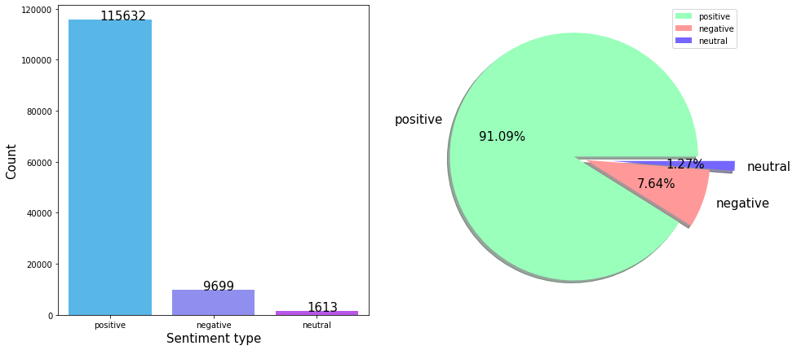
Analysis on review
Conclusion:-
In this, we can observe that the maximum number of customer has given a positive review which is 91% and negative review with 7.64%.

Slide 9
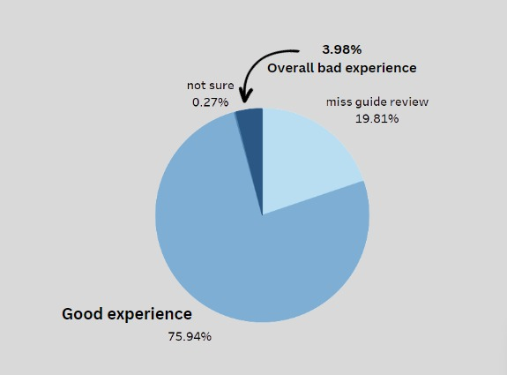
Analysis on review and overall rating
Conclusion:-
Here we had observe that the people has given the most reviews as positive which is 75.94%
Review which are not helpful to other people in term of buying the product is 19.81%.
3.98% customer having bad experience while buying product.

Slide 10
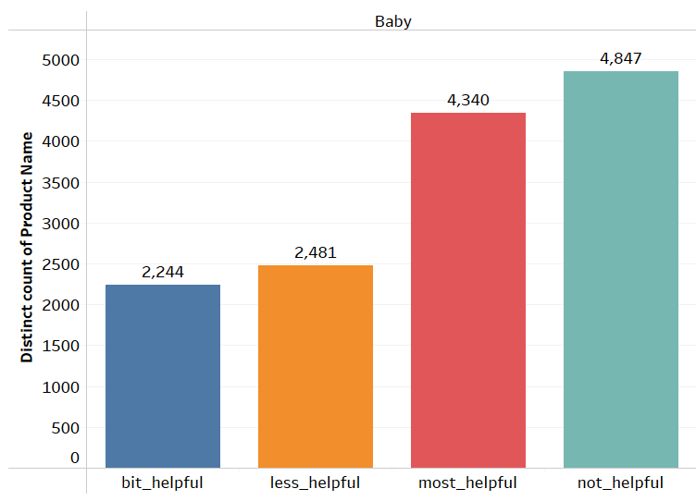
Analysis on helpful ratio
Conclusion:-
Here we had observe that the people has given most review as positive which is 4340,and
There are 4,847 Review which are not helpful to other people in term of buying the product.

Slide 11
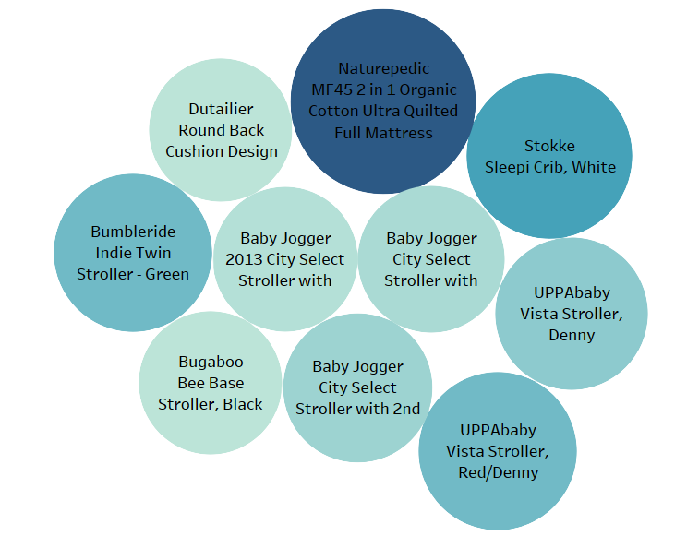
Analysis of the product on the bases of helpful reviews given by customers
Most helpful reviews for this product.
Conclusion:-
In the above chart we can observe the top products which was suggested by the customers and most helpful to the other customers. We can use this product to promote more and we can keep more storage in warehouse.

Slide 12
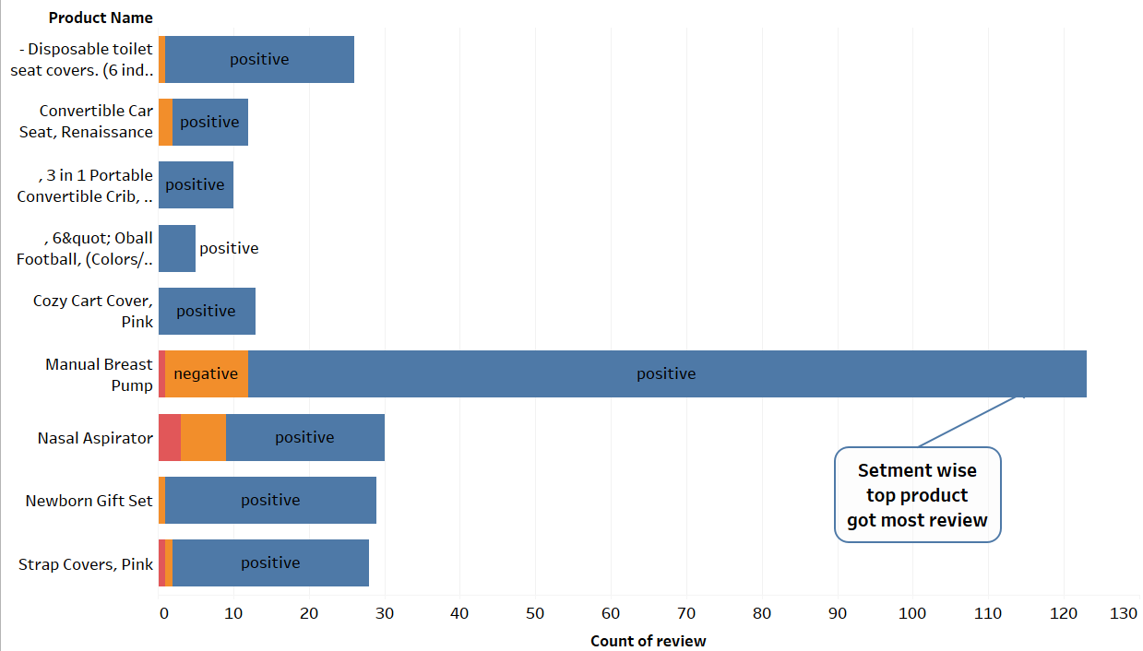
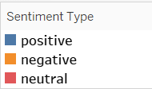
Top products on the basic of segment type and overall experience
This product got 90% positive review only 10% negative
Conclusion:-
In above bar graph we can say that this are the top 10 products on the basic of segment wise , people are most likely to buy them.

Slide 13

TABLEAU DASHBOARD
Analysis of the review on baby category using dashboard.

Slide 14
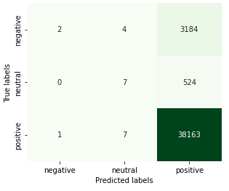
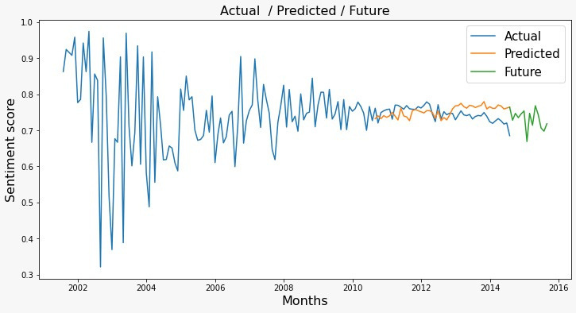
Model evaluation
The traditional manual process of Amazon product reviews is time-consuming and inefficient when millions of reviews are being posted all the time. It doesn’t show any trend or patterns over time.
Multinomial Naïve bayes -
Model performance : 95.31%
Sentiment over the period
Conclusion:-
This model will help businesses in identifying the customer review and future trent automatically.

Slide 15
Solution for business improvement.
There are some loyal customer who wants to chunk out.
Sarah , Amy ,Gissica , Jen
This customer should be given some special attention because this customer are regular to our website.
The product which are worst and having most negative review should be taken some action on them for improvement or stop promoting them on their selling portal.
6 pack soft tip infant spoon, Little snugabunny,Rainforest Jumperoo,Giraffee Teether
The company should increase the product inventory the product which are highly recommended by the customer on their previous experience some of the products are
Manual Breast pump, Nasal Aspirator, Newborn gift set, Strap Cover, Crozy cart
It seems that from period of October to January their highest sales so seller should store bulk stock in their inventory.

Slide 16

Amazon product review on
Clothing Category

Slide 17
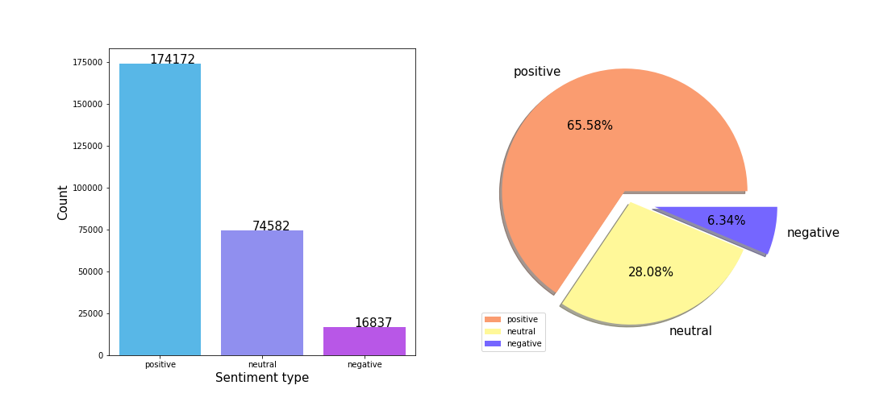
Analysis on review
Conclusion :-
In this, we can observe that the maximum number of customer has given a positive review which is 65.58% and negative review with 6.34 %.

Slide 18
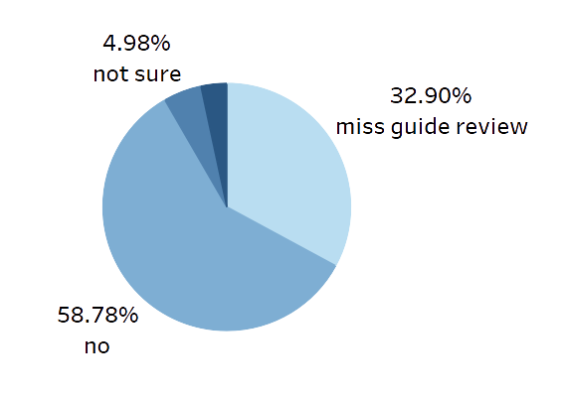


Analysis on review and overall rating
3.34%
Overall bad experience
Good experience
Conclusion:-
Here we had observe that the people has given the most reviews as positive which is 58.78% Review which are not helpful to other people in term of buying the product is 32.90%
3.34% customer having bad experience while buying product.

Slide 19
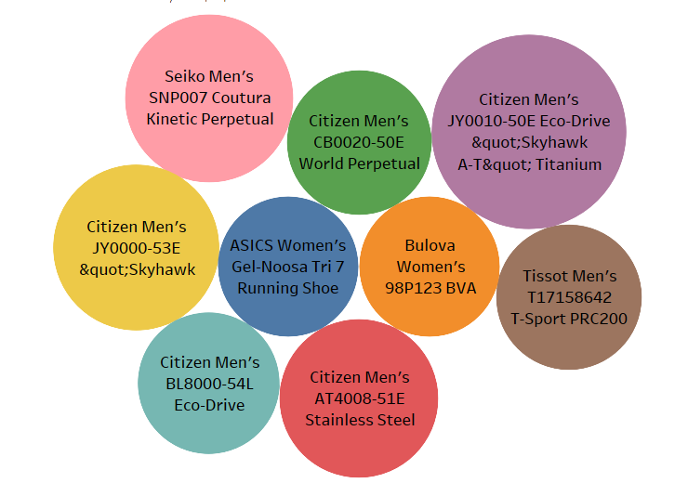
Analysis of the product on the bases of helpful review given by customer.
Most helpful reviews for this product.
Conclusion:-
In the above we had given the top product which were suggested by the customer and most helpful to the other customer. We can use this type of product to promote more and we can keep more storage in warehouse.

Slide 20
TABLEAU DASHBOARD
Analysis of the review on clothing category using dashboard.

Slide 21
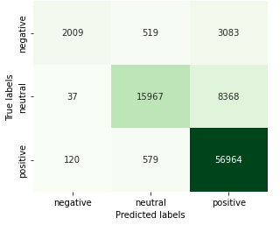
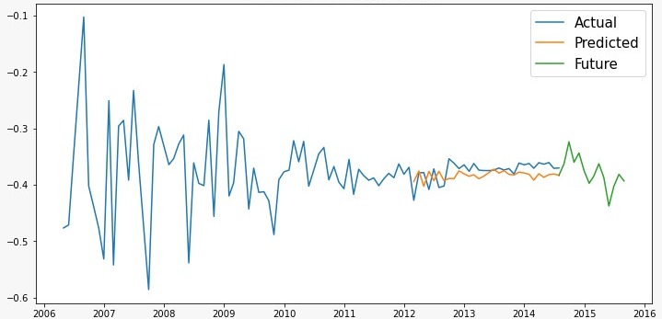
Model evaluation
The traditional manual process of Amazon product reviews is time-consuming and inefficient when millions of reviews are being posted all the time. It doesn’t show any trend or patterns over time.
Multinomial Naive Bayes -
Model performance : 86.81%
Sentiment over the period
Conclucion:-
This model will help businesses in identifying the customer,review and further trent automatically.

Slide 22
Solution for business improvement.
There are some loyal customer who wants to chunk out.
Sarah , Stephanie, Jennifer, Chris, Karen , ect…
This customer should be given some special attention because this customer are regular to our website.
The worst products and those with the majority of negative reviews should either undergo improvement or cease to be promoted on the selling platform.
Vintage Crystal owl Pendant, Spalding women capri, Skechers women Go walk , etc…
Some of the good product which are recommended by the people
Fino bra , Rim wayfarer sunglasses , Cookie polarized sunglasses, etc…
It appears that October to January are the months with the largest sales, thus the merchant should keep large quantities of product on hand.

Slide 23
Amazon product Category
Relation

Slide 24
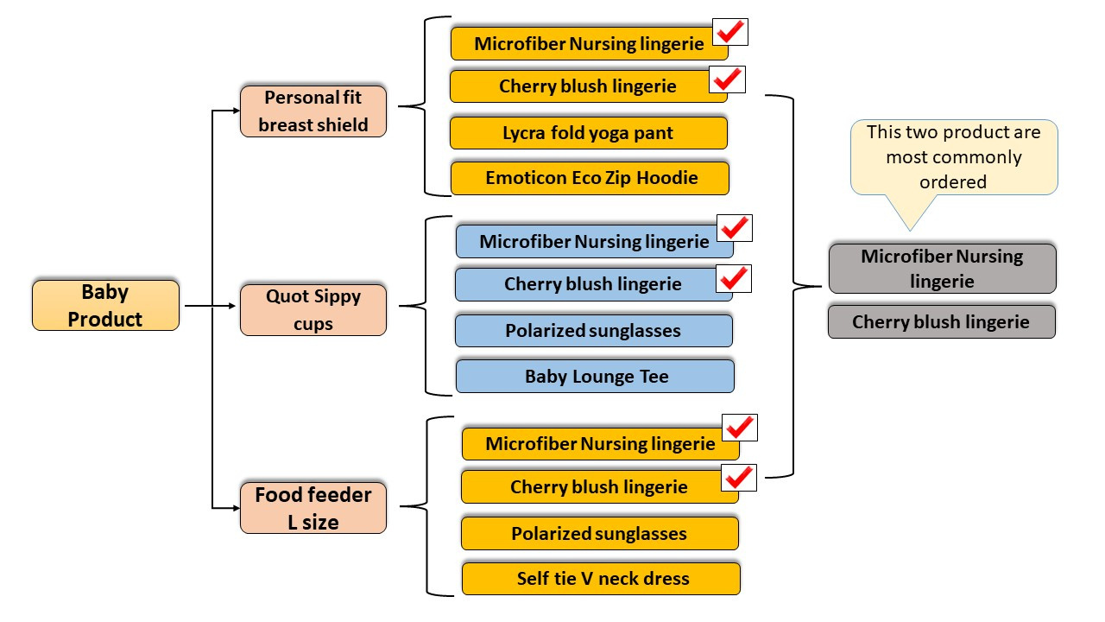
Product recommendation - Baby and Clothing

Slide 25
Conclusion .
We discovered three categories that are related to the clothes category and that consumers like to purchase together. We also discovered that cherry blush and microfiber nursing bras are the two products that consumers purchase the most frequently.
If we want to increase sales we can recommend various combo product which are usually buy by both category like Emoticon Eco Zip Hoodie with Personal fit breast shield , Baby Lounge Tee with Quot Sippy cups and Self tie V neck dress with Food feeder L size etc…
There are some customers who are regular on buying product and willing to chunk they should be given some special attention.
The reason behind negative review are that there were some expensive product and delivery was late and also having inaccurate scale.

Slide 26


